Slide 1
Achieving Excellence in
Talks and Reporting
Winning the Game of Excellence
Deb Timmons
Vanessa Vélez Cruz

Slide 2
Welcome
Prayer
Devotion
Colossians 3:23 -24
“Whatever you are doing, work at it with enthusiasm, as to the Lord and not for people, because you know that you will receive your inheritance from the Lord as the reward. Serve the Lord Christ.”

Slide 3
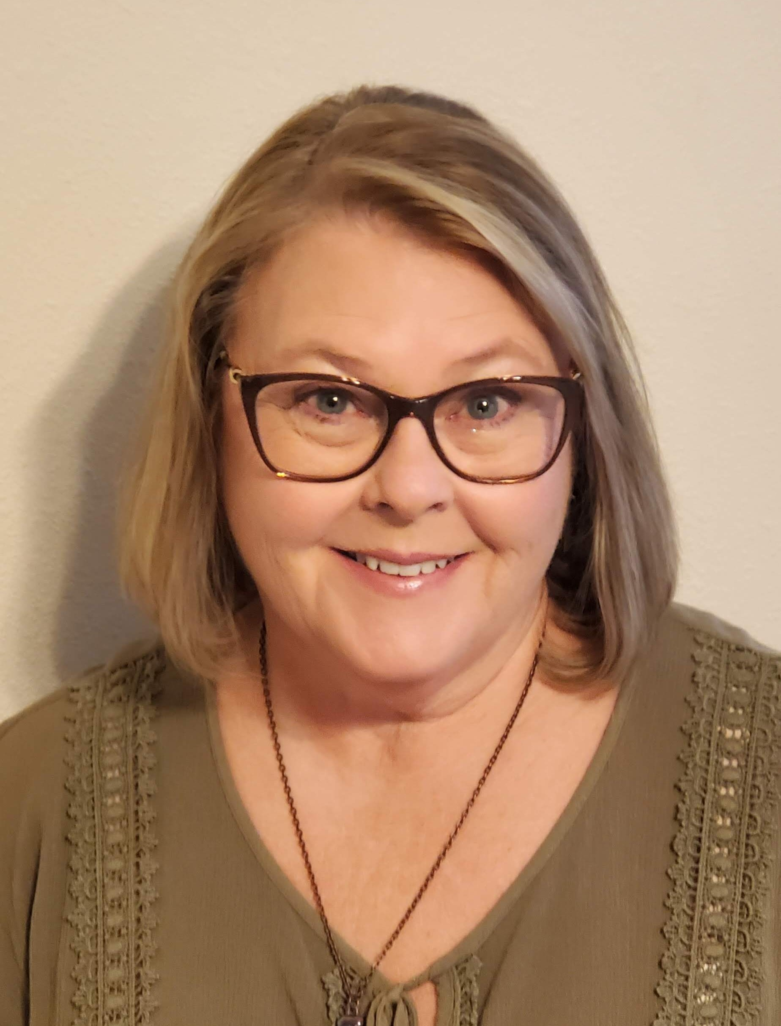
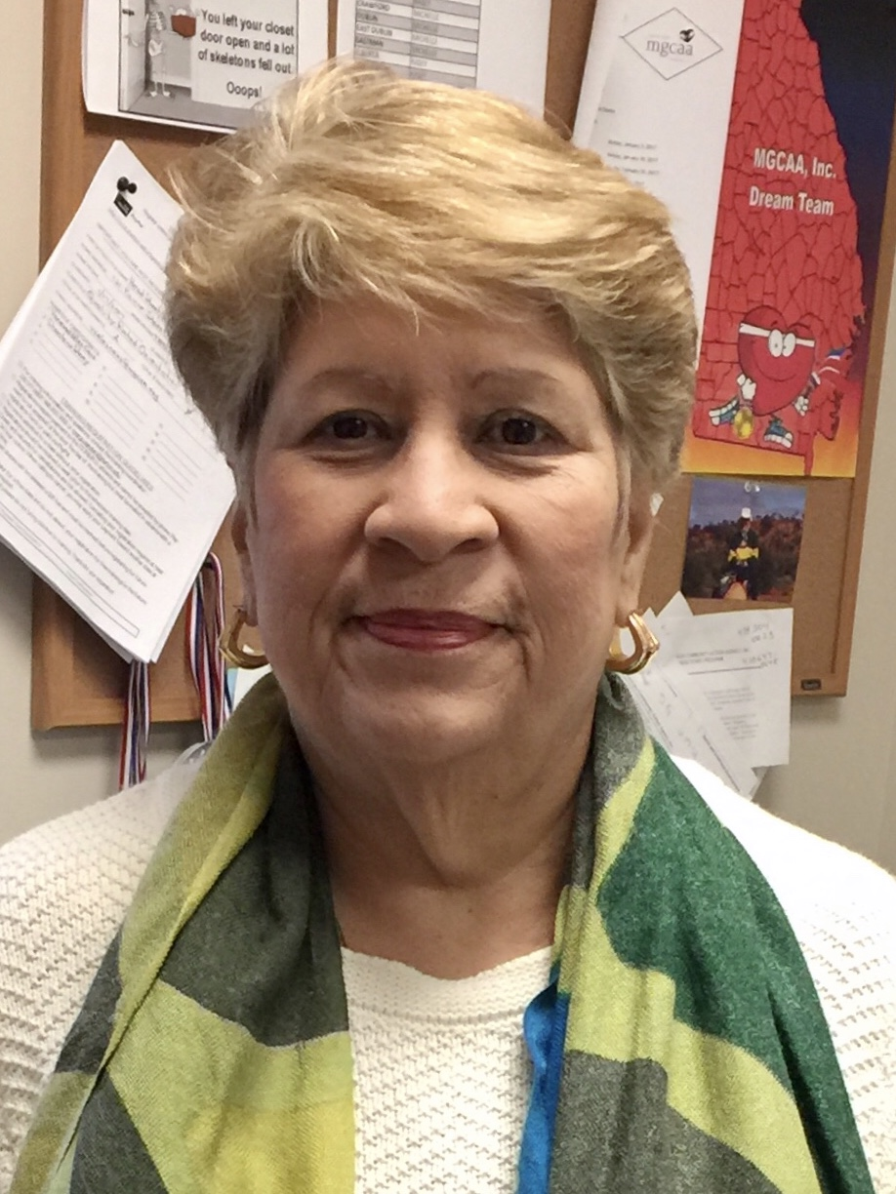
Introductions
Deb Timmons
Vanessa Vélez Cruz

Slide 4
Goal: Seek to Serve God
With excellence in all things and
Through continuous improvement and growth
“Wash, rinse, repeat”

Slide 5
How to Achieve Excellence and
Continuous Improvement?
Excellence is only achieved by intentionally striving to meet or exceed goals
Improvement and growth are only achieved through diligence, assessment and application

Slide 6

Vehicle
Our stories and testimonies are tools to share God’s love and disciple women impacted by incarceration through our personal witness.

Slide 7

Components to Giving Effective Talks and Meditations
Vulnerability & obedience
Honest evaluation
Effective feedback

Slide 8

Evaluation
Review drafts and coaching
Talk Facilitator and Previews
Preview Feedback and Excellence Initiative Observer assessment

Slide 9

Excellence Initiative
“Path to Excellence”
Quality
Effectiveness
Compliance
Identifying need for changes

Slide 10

Communicating Results
Completion of Excellence Initiative
Invite the Excellence Initiative Observer to discuss Areas of Growth.

Slide 11

Measurement and Implementation: “You cannot improve something if you cannot measure it.”
The State and Advisory Council Chair reviews the Excellence Initiative.
Takes the necessary actions to improve the quality of the program.
By reviewing it with the immediate past Weekend Leader and the upcoming Weekend Leader.
The Advisory Council should implement changes, if necessary, after submission.

Slide 12
Measurable Components of the Program
The State and Advisory Council monitor the Leadership Track.
The Advisory Council monitors and enters Continuing Ministry involvement in KairosMessenger.
The State and Advisory Council monitor the success of the Weekend through the Ezra Leader’s Report and the Excellence Initiative.
The State and Advisory Council take the necessary actions to improve the quality of the program.

Slide 13

Questions

Slide 14

Feedback

Slide 15


